Slide 1
Pharmaceutical Management

Slide 2
Management
“Management is a set of activities (including planning and decision making, organizing, leading, and controlling) directed at an organization’s resources, with the aim of achieving organizational goals in an efficient and effective manner.”
Management is the process of planning, organizing, leading, and controlling resources — such as people, money, materials, and time — to achieve organizational goals efficiently and effectively.
Management means getting things done through people in a way that achieves the desired results.

Slide 3
Harold Koontz: “Management is the art of getting things done through and with people in formally organized groups.”
Mary Parker Follett: “Management is the art of getting things done through people.”
Peter Drucker: “Management is doing things right; leadership is doing the right things.”

Slide 4
Nature of Management
Management has several key characteristics that define its nature and role in organizations. Here are the main ones:
1. Goal-Oriented
Management always aims to achieve specific organizational goals effectively and efficiently.
2. Universal
Management principles apply to all types of organizations — business, government, or non-profit — and at all levels.

Slide 5
3. Continuous Process
Management is a never-ending process that involves constant planning, organizing, leading, and controlling.
4. Group Activity
It is a team effort; management involves coordinating the activities of people working together.
5. Dynamic / Flexible
Management adapts to changes in the environment, technology, and market conditions.

Slide 6
6. Intangible Force
Management cannot be seen, but its effect is felt through the efficiency and success of the organization.
7. Integrative Force
It brings together human, financial, and material resources to work harmoniously toward common objectives.
8. Multi-Disciplinary
Management draws knowledge from various fields such as economics, psychology, sociology, and mathematics.

Slide 7
9. Decision-Making Function
Managers are responsible for making important decisions that guide the organization’s direction and performance.
10. Both an Art and a Science
It is a science because it has principles and theories, and an art because it requires personal skills and judgment to apply them.

Slide 8
Principles of Management
Ethics and Social Responsibility Adaptability and Change Management
Employee Empowerment
Diversity and Inclusion
Customer-Centricity
Continuous Improvement

Slide 9
Pharmaceutical Management
The process of managing all functions related to the pharmaceutical sector — such as production, procurement, storage, distribution, and rational use of medicines — to ensure safe, effective, and affordable healthcare delivery.”
Pharmaceutical Management is the branch of management that deals with the planning, organizing, directing, and controlling of activities related to the pharmaceutical industry, including the production, distribution, marketing, and use of medicines.
It combines management principles with pharmacy and healthcare knowledge to ensure the effective and ethical delivery of pharmaceutical products and services.

Slide 10
Pharmaceutical Management is a specialized field that applies the general principles of management to the unique, highly regulated, and research-intensive pharmaceutical industry.
It sits at the intersection of science, business, and healthcare ethics.

Slide 11
Features
Heavy Regulation: Governed by agencies like the FDA (US), EMA (Europe), and others globally. Every step, from lab to patient, is monitored.
High R&D Costs and Risk: Bringing a new drug to market can take 10-15 years and cost over $2 billion, with a high probability of failure.
Long Product Development Cycles: The journey from discovery to commercial launch is extremely long and complex.

Slide 12
Intellectual Property (IP) Intensity: Patents are the lifeblood of the industry, providing a limited period of market exclusivity to recoup R&D investments.
Ethical Imperative: The end product directly impacts human life and health, demanding the highest standards of safety and integrity.
Complex Stakeholder Landscape: Involves patients, physicians, regulators, payers (insurance companies, governments), investors, and advocacy groups.

Slide 13
Objectives
Ensure Quality Medicines: Maintain the quality, safety, and efficacy of drugs throughout their lifecycle.
Optimize Resources: Use financial, human, and material resources efficiently in pharmaceutical operations.
Regulatory Compliance: Adhere to national and international drug laws and standards (e.g., FDA, WHO, GMP).
Improve Accessibility: Make essential medicines available and affordable to all sections of society.

Slide 14
Ethical Marketing: Promote drugs responsibly and ethically, avoiding misleading claims.
Patient Safety and Satisfaction: Ensure correct drug use and enhance patient care.
Sustainability and Innovation: Encourage research, innovation, and environmental responsibility in pharma operations.

Slide 15
Management Vs. Administration
Management deals with managing people and their work to achieve a common goal.
It is a process required at every level of the organization.
The aim is to streamline processes, workflow, goals, and objectives.
It also helps achieve the maximum result.
Managers supervise the entire management process.
They perform duties to manage processes properly, ensuring every process, team, and workflow syncs with changing economic, technological, and socio-political conditions.

Slide 16
Administration is a subset of management, a systematic process of administering management.
It involves building plans, procedures, and policies and enforcing rules to achieve goals.
Administration sets up a framework for organizations on a fundamental level.
More precisely, it involves authorities like bureaucrats.
The administration process involves top-level management.
Administrators deal with the processes to ensure proper administration.

Slide 17
Basis | Management | Administration
Meaning | Management is the process of planning, organizing, leading, and controlling the efforts of people to achieve organizational goals. | Administration is the process of determining the objectives, policies, and overall direction of an organization.
Function | Executes the plans and policies made by the administration. | Formulates plans, policies, and objectives for the organization.
Level of Authority | Middle and lower levels of the organization. | Top level of the organization.
Main Role | Concerned with doing the work — managing resources and operations. | Concerned with deciding what should be done — setting goals and policies.
Nature of Work | Executive and operational. | Decision-making and policy formulation.
Focus | Focuses on managing work and people. | Focuses on setting goals and making rules or policies.
Example | A factory manager implementing production targets. | A board of directors deciding to launch a new product line.
Scope | Narrower — part of administration. | Broader — includes management as one of its parts.

Slide 18
Functions of Management

Slide 19
Planning
Planning is the process by which managers define goals and take necessary steps to ensure that these goals are achieved.
It is the process of determining mission, goals and objectives necessary to achieve therm.
The basic purpose of planning is to make best possible use of organizational resources to attain the goals.
Strategic planning deals with the environment.
Short term planning are called tactical plan.

Slide 20
Organizing
Organizing involves the assignment of functions and tasks to groups and to individual employees.
Organizing involves the allocation of roles, tasks, and functions to individuals and departments of an organization.
Organization structure, staffing, division of work, assignment of responsibility, work rules, commitment, and coordination are integral parts of organizing functions.

Slide 21
Leading
Leadership is the process of directing and influencing the task related activities of group members.
Leading function involves several activities such as order giving, supervising, directing, conflict resolving, motivating and communicating.

Slide 22
Controlling
Control is a systematic effort to set performance standards with planning objectives to design information feedback, to compare actual performance with these predetermined standards, to determine whether there are any variations and to measure their significance, and to take necessary corrective actions to achieve corporate objectives.
It involves the evaluation of operating results as compared with established standards.

Slide 23
Process of Management

Slide 24
Management process is a distinct process consisting of planning, organizing, actuating and controlling, performed to determine and accomplish stated objective by the use of human beings and other resources.
Management process is a systematic way of doing managerial activities like planning, organizing, directing, controlling and decision making.

Slide 25
Objectives
Men
Money
Materials
Machines
Methods
Market
Output
Inputs
Planning
Leading
Controlling
Management Process
Organizing
Motivating
Staffing
End Result

Slide 26
A Social process
An integrative process
A governance process
Universal process
Continuous process

Slide 27
Managerial Hierarchy and Levels
Managerial hierarchy depicts the chain of command.
Top Level Management
Middle Level Management
Lower Level Management

Slide 28
Top Level Management
It consists of board of directors, chief executive or managing director.
The top management is the ultimate source of authority and it manages goals and policies for an enterprise.
It devotes more time on planning and coordinating functions.
The role of the top management can be summarized as follows -

Slide 29
Top management lays down the objectives and broad policies of the enterprise.
It issues necessary instructions for preparation of department budgets, procedures, schedules etc.
It prepares strategic plans policies for the enterprise.
It appoints the executive for middle level i.e. departmental managers.
It controls coordinates the activities of all the departments.
It is also responsible for maintaining a contact with the outside world.
It provides guidance and direction.
The top management is also responsible towards the shareholders for the performance of the enterprise.

Slide 30
Middle Level Management
The branch managers and departmental managers constitute middle level. They are responsible to the top management for the functioning of their department.
They devote more time to organizational and directional functions.
In small organization, there is only one layer of middle level of management but in big enterprises, there may be senior and junior middle level management.
Their role can be emphasized as -

Slide 31
They execute the plans of the organization in accordance with the policies and directives of the top management.
They make plans for the sub-units of the organization.
They participate in employment training of lower level management.
They interpret and explain policies from top level management to lower level.
They are responsible for coordinating the activities within the division or department.
It also sends important reports and other important data to top level management.
They evaluate performance of junior managers.
They are also responsible for inspiring lower level managers towards better performance.

Slide 32
Lower Level Management
Lower level is also known as supervisory/operative level of management.
It consists of supervisors, foreman, section officers, superintendent etc.
According to R.C. Davis, “Supervisory management refers to those executives whose work has to be largely with personal oversight and direction of operative employees”.
In other words, they are concerned with direction and controlling function of management.
Their activities include -

Slide 33
Assigning of jobs and tasks to various workers.
They guide and instruct workers for day to day activities.
They are responsible for the quality as well as quantity of production.
They are also entrusted with the responsibility of maintaining good relation in the organization.
They communicate workers problems, suggestions, and recommendatory appeals etc. to the higher level and higher level goals and objectives to the workers.

Slide 34
They help to solve the grievances of the workers.
They supervise guide the sub-ordinates.
They are responsible for providing training to the workers.
They arrange necessary materials, machines, tools etc for getting the things done.
They prepare periodical reports about the performance of the workers.
They ensure discipline in the enterprise.
They motivate workers.
They are the image builders of the enterprise because they are in direct contact with the workers.

Slide 35
Managerial Skills
An ability or proficiency in performing a particular task.
Technical Skills
It is the ability to process the technical side of the job.
It is the job specific knowledge and techniques that are required to perform an organizational role.
For example a production manager must have the skills to plan, operate, maintain, and repair machines and equipment.

Slide 36
Human skills
Human skills is the power to communicate with fellow workers.
A manager needs knowledge and skills in fields such as communication, motivation, conflict management, group dynamics etc.

Slide 37
Conceptual skills
It involves the formulation of ideas and concepts.
It is the ability of the manager to visualize the organization in its totality and its environment.
Analytical skills
Diagnostic skills
Decision making skills
Computer skills
Communication skills
Institution building skills

Slide 38
What is a Role?
The expected behaviour for a certain status or position.

Slide 39
Managerial Roles
What you do as a manager (tasks / functions)?

Slide 40
The Managerial Roles
Interpersonal roles
Informational roles
Decisional roles

Slide 41
Interpersonal Roles
Managers develop contacts and build relationships with people inside and outside the organization.
Figurehead role
Leader role
Liaison role

Slide 42
Informational roles
Informational roles are closely related with tasks necessary to obtain and transmit information.
Monitor role
Disseminator role
Spokesperson role

Slide 43
Decisional role
Decisional roles are closely associated with the methods managers use to plan strategy and utilize resources.
Entrepreneurship
Disturbance handler role
Resource allocator role

Slide 44
Category | Role | Activity | Examples
Informational (managing by information) | Monitor | Seek and acquire work-related information | Scan/read trade press, periodicals, reports; attend seminars and training; maintain personal contacts
 | Disseminator | Communicate/ disseminate information to others within the organization | Send memos and reports; inform staffers and subordinates of decisions
 | Spokesperson | Communicate/transmit information to outsiders | Pass on memos, reports and informational materials; participate in conferences/meetings and report progress

Slide 45
Interpersonal (managing through people) | Figurehead | Perform social and legal duties, act as symbolic leader | Greet visitors, sign legal documents, attend ribbon cutting ceremonies, host receptions, etc.
 | Leader | Direct and motivate subordinates, select and train employees | Includes almost all interactions with subordinates
 | Liaison | Establish and maintain contacts within and outside the organization | Business correspondence, participation in meetings with representatives of other divisions or organizations.

Slide 46
Decisional (managing through action) | Entrepreneur | Identify new ideas and initiate improvement projects | Implement innovations; Plan for the future
 | Disturbance Handler | Deals with disputes or problems and takes corrective action | Settle conflicts between subordinates; Choose strategic alternatives; Overcome crisis situations
 | Resource Allocator | Decide where to apply resources | Draft and approve of plans, schedules, budgets; Set priorities
 | Negotiator | Defends business interests | Participates in and directs negotiations within team, department, and organization

Slide 47
Management Theories

Slide 48
Why Management History?
To understand where ideas came from.
To see the role of social, legal, political, economic, technological factors in developing management thought and practice.

Slide 49
The Industrial Revolution [1760-1840]
The Industrial Revolution results a major turning point in human history;
The Revolution that changed the world forever
Industrial Revolution – a change from making things by hand to making them in factories.

Slide 50
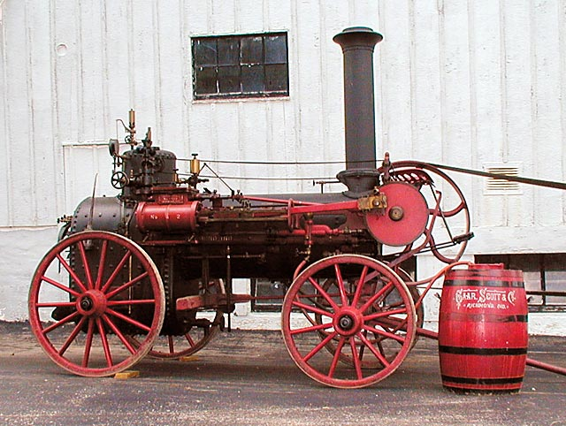
An original steam engine

Slide 51
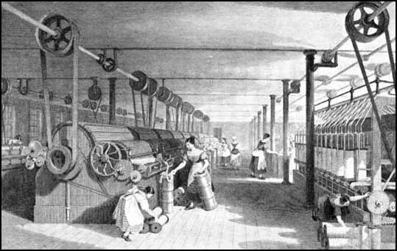
A cotton factory

Slide 52
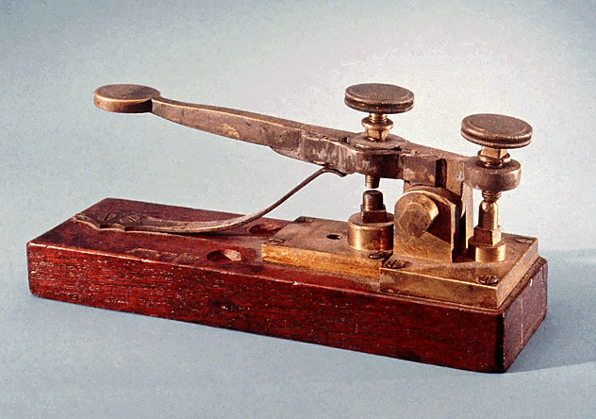
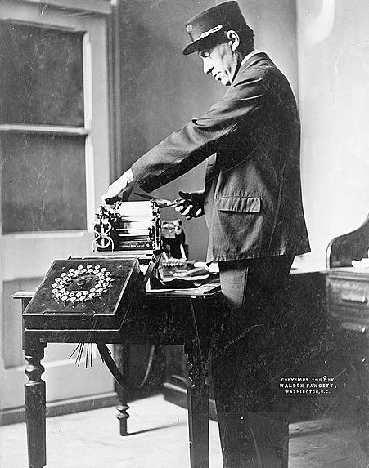
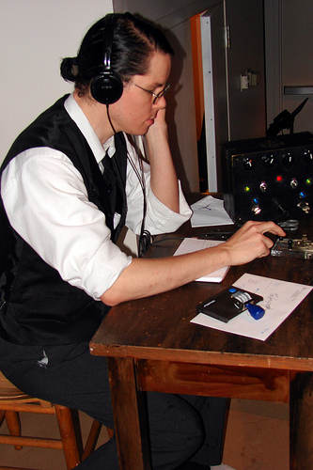

Slide 53
The Industrial Revolution – New Technology
Manufacturing
Steam engines
Cotton gin
Mass production through standardization and specialization
Transportation
Steam powered ships
Railroads
Communications
Telegraph

Slide 54
Large Organizations and New Approaches to Management
Economic transformation
Previously – family farms, small workshops.
After Industrial Revolution – large organizations, requiring management skills .
New demands on management:
Need for professional managers (as opposed to owners)
Need to plan, structure, and schedule activities.
Need for worker training and socialization to factory work.

Slide 55
Management Perspectives Over Time
2000
The Technology-Driven Workplace
1990
2010
The Learning Organization
1980
2010
Total Quality Management
2000
1970
Contingency Views
1950
2000
Systems Theory
1940
2000
Management Science Perspective
1990
1930
Humanistic Perspective
1890
1990
Classical
1940
1870

Slide 56
Schools of Management Thought
Classical School
Scientific management.
Administrative Principles.
Behavioral School
Human Relationships Approach
Management Science School
Recent Historical Development
Systems Theory
Contingency Theory

Slide 57
Scientific Management: Frederick Taylor (1856-1915)
Frederick Taylor was an American mechanical engineer who wanted to improve industrial efficiency.
He is considered as the father of scientific management.
Worked at Midvale Steel (beginning as a common worker, chief engineer, in 6 years)
Started with time study and motivation plans.
Taylor wanted to reduce the time a worker spent on each task by optimizing the way the task was done.
Notes:
Fredrick Winslow Taylor (1856-1915)

Slide 58
Scientific Management: Frederick Taylor (1856-1915)
Scientific Management as defined by Frederick Taylor:
The systematic study of the relationships between people and tasks to redesign the work for higher efficiency.

Slide 59
The 4 Principles
Four Principles to increase efficiency:
Study the way the job is performed now & determine new ways to do it.
Organize the new method into rules.
Select workers whose skills match the rules.
Establish a fair level of performance and pay for higher performance.

Slide 60
Scientific Management: summarize
Contributions:
Pay for performance.
Careful examination of job tasks.
Importance of training and selection.
But……..* Problems
Assumed workers were robot without social needs or human needs.
Assumed all individuals were the same.

Slide 61
Administrative Principles Theory: Henry Fayol (1841–1925)
Henri Fayol (1841- 1925) was a French mining engineer.
He was one of the most influential contributors to modern concepts of management.
Focus:
Organization rather than the individual.
Described the management functions of planning, organizing, coordinating, and controlling.

Slide 62
Fayol’s Principles
Henri Fayol, developed a set of 14 principles:
1. Division of work: allows for job specialization.
2. Authority and Responsibility:
3. Unity of Command: Employees should have only one boss.
4. Line of Authority: a clear chain from top to bottom of the firm.
5. Centralization: the degree to which authority rests at the very top.

Slide 63
Fayol’s Principles
6. Unity of Direction: One plan of action to guide the organization.
7. Equity: Treat all employees fairly in justice and respect.
8. Order: Each employee is put where they have the most value.
9. Initiative: Encourage innovation.
10. Discipline: respectful employees needed.

Slide 64
Fayol’s Principles
11. Compensation of Employees : The payment system contributes to success.
12. Stability of Employees : Long-term employment is important.
13. General interest over individual interest: The organization takes priority over the individual.
14. Common spirit: Share enthusiasm or loyalty to the organization.

Slide 65
Fayol’s 14 Principles
Division of work
Authority and Responsibility
Unity of command
Line of authority
Centralization
Unity of Direction
Equity
Order
Initiative
Discipline
Compensation
Stability of Employees
General interest over individual interest
Common spirit

Slide 66
Behavioral Management School
Focuses on the way a manager should personally manage to motivate employees.
Behavioral management theory is often called the human relations movement because it addresses the human dimension of work.
The theorists who contributed to this school viewed employees as individuals, resources, and assets to be developed and worked with — not as machines, as in the past.

Slide 67
Theory X and Y
Douglas McGregor proposed the two different sets of worker molds.
Theory X - Classical Theory :
1. Assumes the average worker is lazy, dislikes work and will do as little as possible.
2. Managers must closely supervise and control through reward and punishment.
Theory Y- Human relationships Theory :
1. Assumes workers are not lazy, want to do a good job and the job itself will determine if the worker likes the work.
2. Managers should allow the workers feel freedom, and exercise initiative and self-direction.

Slide 68
Theory X / Theory Y
Theory X
Theory Y
Employee is lazy.
Managers must
closely supervise.
Create strict rules & defined rewards
Employee is not lazy.
Must create work setting to build initiative.
Provide authority to workers.

Slide 69
Management Science Theory
Quantitative management :
Uses mathematical techniques, like linear programming, modeling, simulation and chaos theory
Operations management :
Provides managers a set of techniques they can use to analyze any aspect of an organization’s production system to increase efficiency

Slide 70
Management Science Theory
Total quality management :
Focuses on analyzing an organization’s input, conversion, and output activities to increase product quality
Management information systems :
Help managers design systems that provide information that is vital for effective decision making

Slide 71
The System Theory
What’s the system approach?
Two basic types of the system: closed and open
Closed systems are not influenced by and do not interact with their environment.
Open system dynamically interacts with its environment.
An organization is an open system

Slide 72
An Organization Is an Open System
An organization is a system that interacts with and depends upon its environment.
Organization’s stakeholders: any group that is affected by organizational decisions and policies. The manager’s job is to coordinate all stakeholders to achieve the organization’s goals.
Organizational survival often depends on successful interactions with the external environment.

Slide 73
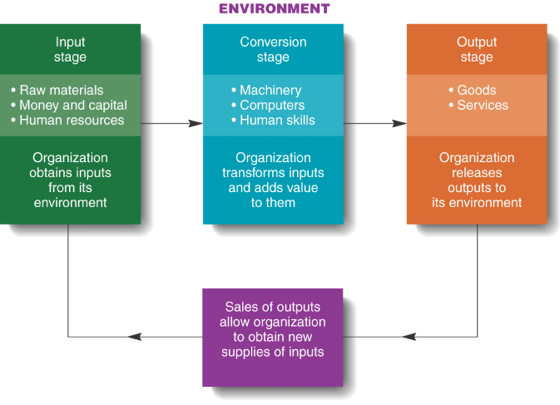

Slide 74
The Open-Systems View
Inputs: the acquisition of external resources to produce goods and services.
Transformation: transforms the inputs into outputs of finished goods and services.
Output: the release of finished goods and services to its external environment.

Slide 75
Maslow’s Hierarchy-of-Needs Theory
Abraham Maslow )1908-1970).
Father of Humanistic Psychology.
Maslow's hierarchy of needs theory is a motivational theory in psychology containing a five level model of human needs, often shown as hierarchical levels within a pyramid.

Slide 76
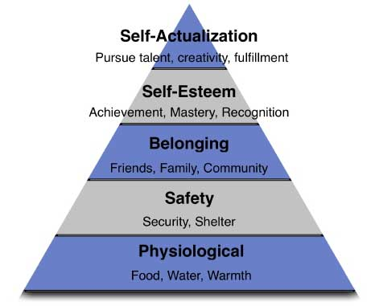
Maslow’s Hierarchy-of-Needs Theory

Slide 77
Definition of Production Management
Production management is a function of management, related to planning, organizing implementing, coordinating and controlling the resources activities required to produce specified product by specified methods with optimal utilization of resources.
Production management is defined as management function which plans, organizes, coordinates, directs and controls the material supply and processing activities of an enterprise, so that specified products are produced by specified methods to meet an approved sales programme.
These activities are being carried out in such a manner that labour, plant and capital available are used to the best advantage of the organization.

Slide 78
Objectives of Production Management
Produce the desired product or specified product by specified methods with optimal utilization of available resources.
Produce products which are cost efficient and conforming to the quality.
Deliver right goods of right quality at right place at the right price.

Slide 79
Types of Production Process
There are four types of production process that are distinct and require different conditions for their working.
Selection of production process is a strategic decision, which requires to be considered and decided at the stage of planning itself.
It should meet the basic two objectives i.e. to meet the specification of the final product and should be cost effective.

Slide 80
Classification of Manufacturing Process
The manufacturing process is classified into four types.
Job production
Batch production
Mass or flow production
Process Production

Slide 81
Classification of Manufacturing Process
Job production
Herein one or few units of the products are produced as per the requirement and specification of the customer.
Production is to meet the delivery schedule and costs are fixed prior to the contract.
Batch production
In this, limited quantities of each of the different types of products are manufactured on same set of machines.
Different products are produced separately one after the other.
Mass or flow production
Under this, the production is conducted on a set of machines arranged according to the sequence of operations.
A huge quantity of same product is manufactured at a time and is stocked for sale.
Different product will require different manufacturing lines.
Process production
Under this, the production is conducted continuously for an indefinite period to meet continuous market demand.

Slide 82
Scope of Production Management
An organization must follow the principles of management for its survival and growth.
The same is applicable to production management also.
Reading and learning production management will enable one to be capable of solving the problems of the organization.
The problems a manager face in various organizations are more or less similar to that of Production department but smaller in magnitude.
Knowledge of Production Management helps professionals to tackle the problems of business, including dairy industry.

Slide 83
Logistic Management
Definition
The planning, execution, and control of the movement / placement of goods and / or people, and the related supporting activities, all within a system designed to achieve specific objectives.
Logistics Management
"Logistics management is that part of supply chain management that plans, implements, and controls the efficient, effective forward and reverse flow and storage of goods, services and related information between the point of origin and the point of consumption in order to meet customers' requirements”.

Slide 84
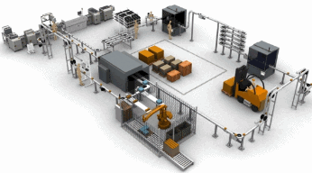
Areas of Logistics Management
Procurement Logistics
Production Logistics
Distribution Logistics
Disposal Logistics

Slide 85
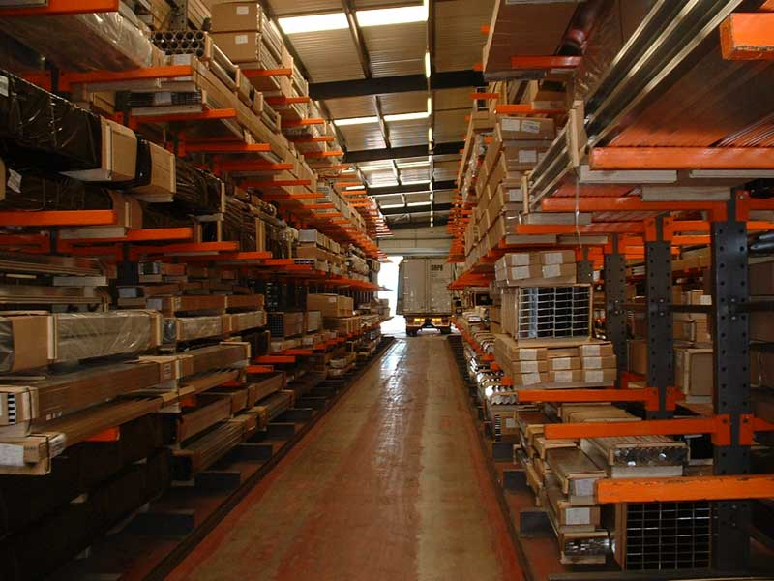
ACTIVITIES INVOLVED IN LOGISTICS MANAGEMENT
Order processing
Inventory management
Material planning
Warehousing
Transportation.

Slide 86
Types of Logistics Management
Supply Management and Logistics
Distribution and Material Movement
Production Logistics and Management
Reverse Logistics and Product Return

Slide 87
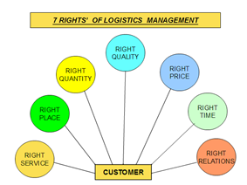

Slide 88

OBJECTIVES OF LOGISTICS
OPERATING OBJECTIVES
Rapid response
Minimum variance
Quality

Slide 89
Advantages of logistic
A better use of the distribution network
Costs reduction
Transportation and express delivery
Information technology

Slide 90
Disadvantages of the logistics
Coordination
Multinationals and large companies
Cost of transport
Legality

Slide 91
MANAGEMENT INFORMATION SYSTEM

Slide 92
Definition
A Management Information System (MIS) is a system that collects, processes, and analyzes data to support business decision-making at all levels of management.
It helps organizations operate more efficiently, track performance, and make data-driven choices.
Essentially, MIS provides tools to manage information and knowledge within an organization, enabling better planning, control, and coordination.

Slide 93
Management : Management is art of getting things done through and with the people in formally organized groups.
The basic functions performed by a manager in an organization are: Planning, controlling, staffing, organizing, and directing.
Information : Information is considered as valuable component of an organization.
Information is data that is processed and is presented in a form which assists decision maker.
System : A system is defined as a set of elements which are joined together to achieve a common objective.
The elements are interrelated and interdependent.
Thus every system is said to be composed of subsystems.
A system has one or multiple inputs, these inputs are processed through a transformation process to convert these input( s) to output.

Slide 94
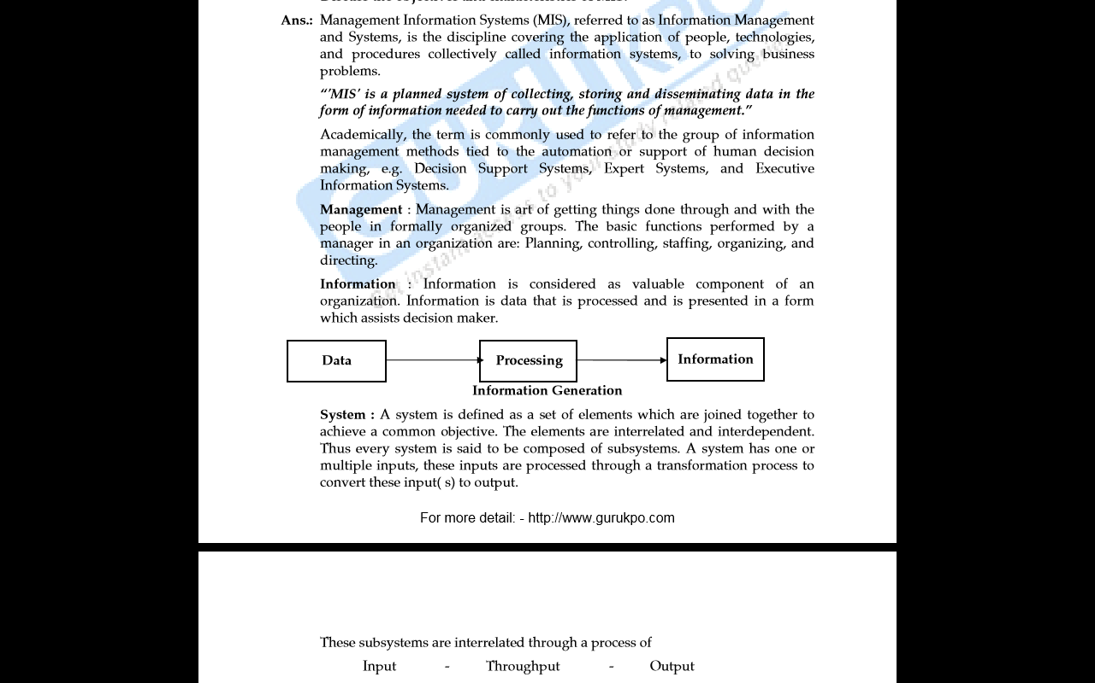

Slide 95
Objectives of MIS
The main objectives of a Management Information System (MIS) are to support effective decision-making by providing timely, accurate, and relevant information to managers at all levels.
This includes enabling efficient operations, facilitating business process support, and contributing to strategic advantages.

Slide 96
Key Objectives of MIS
Decision Support:
MIS provides information that helps managers make informed decisions about various aspects of the business, including planning, operations, and control.
Business Process Support:
MIS is designed to support and streamline business processes, making them more efficient and effective.
Competitive Advantage:
By providing timely and accurate information, MIS can help organizations gain a competitive edge in the market.

Slide 97
Data Collection and Processing
MIS collects data from various internal and external sources and processes it into meaningful information for analysis and decision-making.
Information Storage and Retrieval
MIS provides a secure and accessible system for storing and retrieving information, allowing users to access the data they need when they need it.

Slide 98
Communication and Collaboration:
MIS can facilitate communication and collaboration among employees and departments by providing a centralized source of information.
Risk Management:
By providing data and insights into business operations, MIS can help identify and manage risks effectively.
Improved Operational Efficiency:
MIS can help improve operational efficiency by providing tools for monitoring, tracking, and controlling key performance indicators (KPIs).

Slide 99
Components of MIS
People
Users: These are the individuals who interact with the MIS, including managers, employees, and external stakeholders.
Support Staff: IT professionals who maintain and support the system.
Data
Raw Data: The fundamental input to the MIS, including internal and external information.
Examples: Customer information, sales figures, financial data, inventory records.
Hardware
Physical Components:
These include computers, servers, networking equipment, and peripherals like printers.
Purpose:
Facilitates input, processing, storage, and output of data and information.

Slide 100
Software:
Programs and Applications: The software that runs on the hardware, enabling data processing, analysis, and reporting.
Examples: Database software, spreadsheet programs, ERP systems, CRM systems.
Business Procedures:
Policies and Protocols: Established methods and procedures for how data is collected, processed, stored, and used.
Examples: Data capture, data processing, data storage, retrieval, and dissemination.
Additional Considerations:
Data Analysis: Tools and techniques used to analyze data and extract meaningful insights.
Reporting: MIS provides reports to managers, which can be routine, on-demand, or exception-based.
Integration: MIS often integrates with other business systems, such as transaction processing systems (TPS).

Slide 101
Importance of MIS
Enhanced Decision-Making
MIS provides accurate and timely data, enabling managers to make informed decisions based on real-time insights.
It helps identify opportunities and problems quickly, allowing for proactive responses and adjustments.
By providing data analysis and reports, MIS facilitates the understanding of business performance and trends.

Slide 102
Streamlined Operations
MIS automates and integrates various business processes, reducing redundancy and minimizing errors.
It improves operational efficiency by automating routine tasks and providing easy access to information, allowing employees to focus on more strategic activities.
MIS can streamline workflows and boost productivity by providing clear roles and responsibilities.
Competitive Advantage
MIS provides businesses with a competitive edge by delivering timely and accurate information.
It helps organizations track customer activity and preferences, enabling the development of targeted marketing campaigns and improved customer service.

Slide 103
Improved Communication and Collaboration
MIS enhances internal communication and facilitates collaboration between different teams and departments.
It can be used for managing schedules, editing information, and facilitating communication.
Cost Savings and Efficiency
By streamlining processes and automating tasks, MIS can lead to significant cost savings and increased efficiency.
It also helps in managing resources more effectively and optimizing workflows.
Performance Monitoring and Analysis
MIS allows businesses to monitor performance against objectives and identify trends.
It provides tools for analyzing data, identifying strengths and weaknesses, and tracking employee performance.
This allows for proactive adjustments and improvements to business processes.

Slide 104
Thank You

